Slide 1


Welcome to the Strategy Summit slide deck template!
A few quick tips on how to use this deck:
Note:
Inserting logos:
Additional information:
You are ONLY required to use the Strategy Summit themed title slide and speaker slide. You may however choose to use the full themed template.
The bottom of the slide is reserved for your logo. If you’d like to add one, click the image icon in the box at the bottom of each slide.
Select a logo that is roughly the same shape as the placeholder.
If your logo is cut off after inserting, navigate to the main menu above and click “Insert,” “Picture,” and then “Picture from File.” Select the image of your logo from your computer and select ”Insert.”
Size your logo and move to a similar size and location as the placeholder.
Delete the placeholder.
Copy your logo and paste on each slide.
If you would like to know more about the basics of navigating PowerPoint, visit Microsoft’s support portal here.
Please delete all the quick tips slides and any slides you will not use in your presentation.
We’re excited to see you at TICE and good luck!
Adding duplicate slides:
Hover mouse over the slide you want to duplicate and right click.
Click ”Duplicate Slide” and a duplicate of the slide will appear below it.

Slide 2
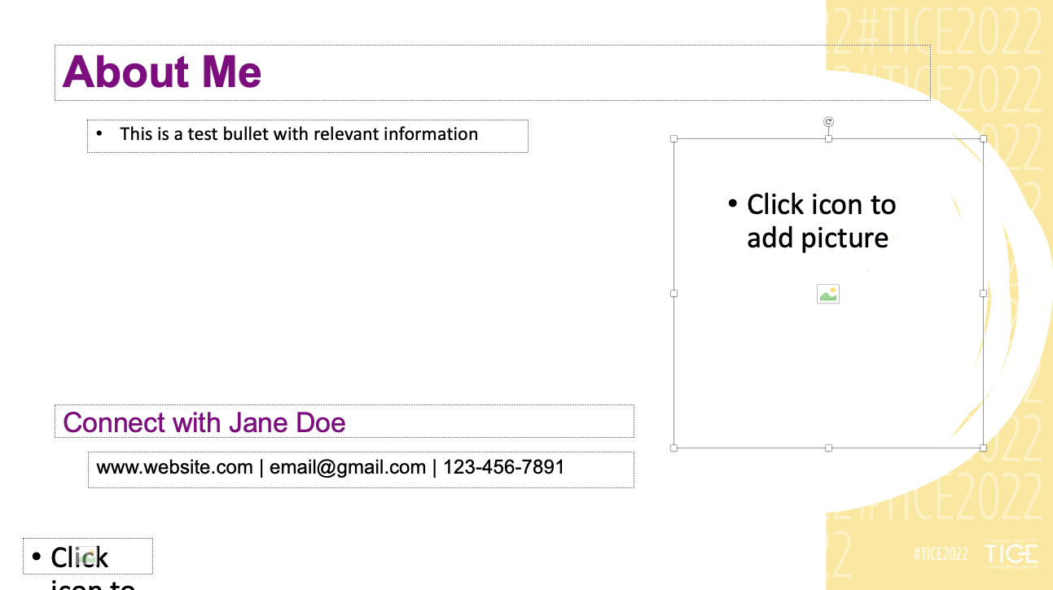
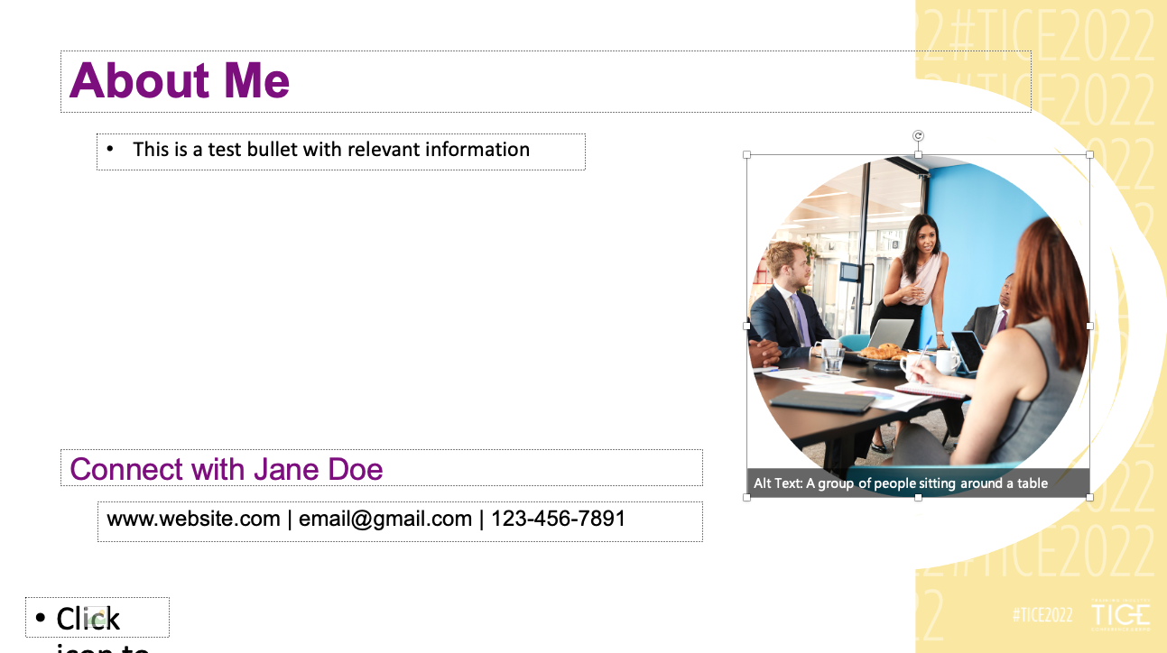
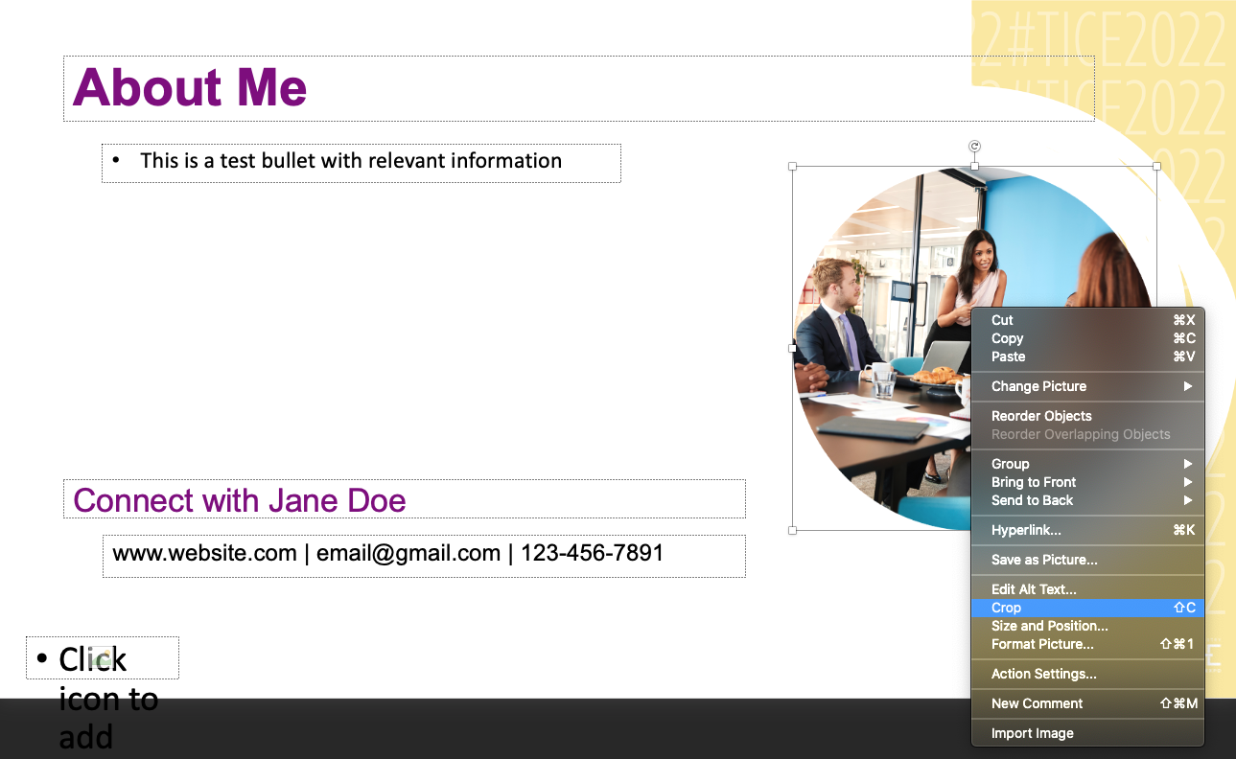
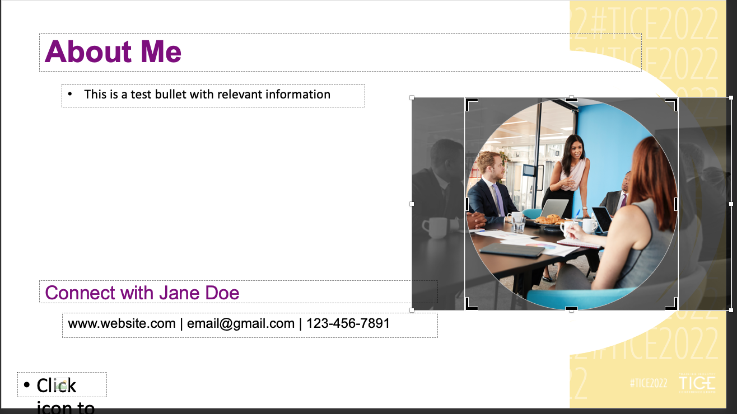
Adding and editing images
Click image icon in placeholder field.
Click an image saved on your computer and select “Insert.”
To move the image or adjust the size, right click the image and select “Crop.”
Click and hold the image to move it in any direction. To increase or decrease the size of the image, click and drag the white squares. Do not click and drag the black triangles as this will alter the template.
1
2
3
4

Slide 3

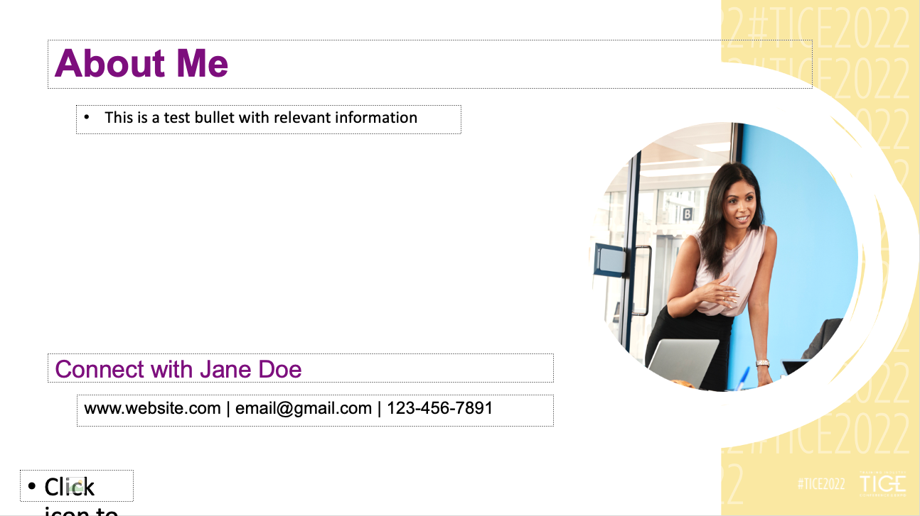
Adding and editing images
In this example, the image has been increased.
To complete the image edits, click “Crop” in the main menu bar above.
The completed process.
5
7
6

Slide 4


